Slide 1

NLP and Word Embeddings
Word representation
deeplearning.ai

Slide 2
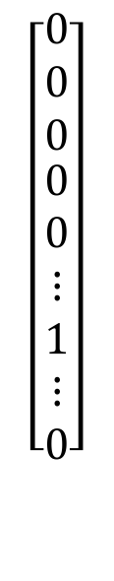
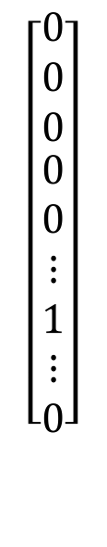
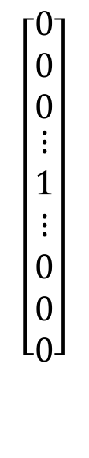
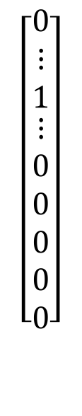
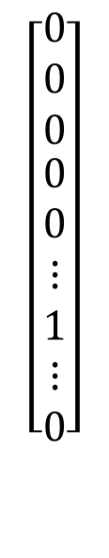
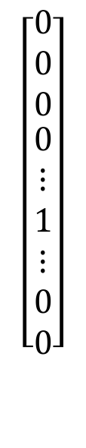
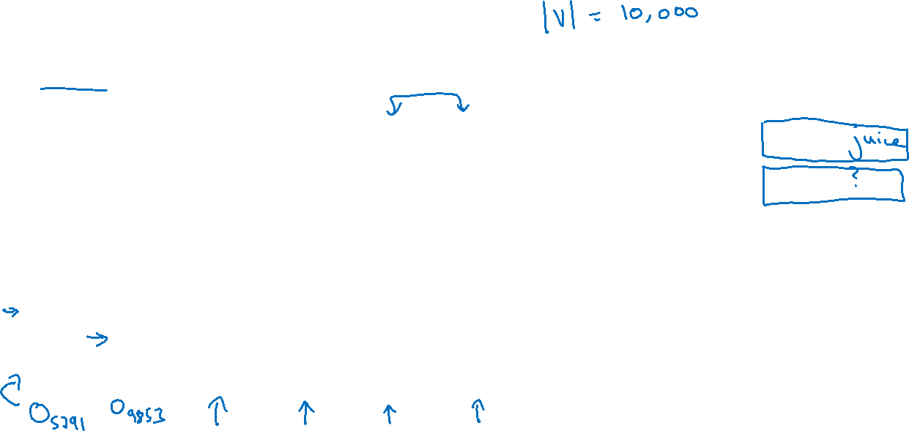
Word representation
V = [a, aaron, …, zulu, <UNK>]
1-hot representation
Man
(5391)
Woman
(9853)
King
(4914)
Queen
(7157)
Apple
(456)
Orange
(6257)
I want a glass of orange ______.
I want a glass of apple______.
$$\left[\begin{aligned}\begin{matrix}0 \\ 0 \\ 0\end{matrix} \\ 0 \\ ⋮ \\ 1 \\ ⋮ \\ 0 \\ 0\end{aligned}\right]$$
$$\left[\begin{aligned}\begin{matrix}0 \\ 0 \\ 0\end{matrix} \\ 0 \\ 0 \\ ⋮ \\ 1 \\ ⋮ \\ 0\end{aligned}\right]$$
$$\left[\begin{aligned}\begin{matrix}0 \\ 0 \\ 0\end{matrix} \\ ⋮ \\ 1 \\ ⋮ \\ 0 \\ 0 \\ 0\end{aligned}\right]$$
$$\left[\begin{aligned}\begin{matrix}0 \\ 0 \\ 0\end{matrix} \\ 0 \\ 0 \\ ⋮ \\ 1 \\ ⋮ \\ 0\end{aligned}\right]$$
$$\left[\begin{aligned}\begin{matrix}0 \\ ⋮ \\ 1\end{matrix} \\ ⋮ \\ 0 \\ 0 \\ 0 \\ 0 \\ 0\end{aligned}\right]$$
$$\left[\begin{aligned}\begin{matrix}0 \\ 0 \\ 0\end{matrix} \\ 0 \\ 0 \\ ⋮ \\ 1 \\ ⋮ \\ 0\end{aligned}\right]$$

Slide 3
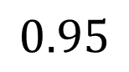
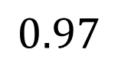
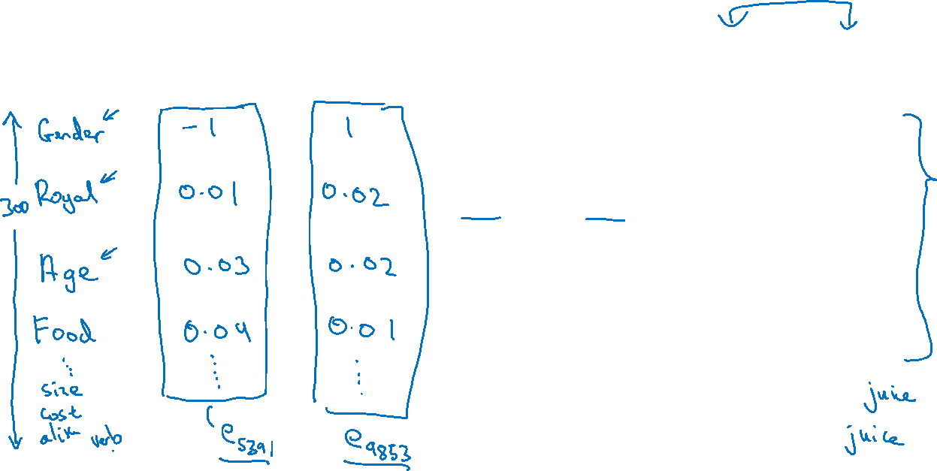
Featurized representation: word embedding
Man
(5391)
Woman
(9853)
King
(4914)
Queen
(7157)
Apple
(456)
Orange
(6257)
-0.95
$$0.97$$
0.00
0.01
0.93
$$0.95$$
-0.01
0.00
0.7
0.69
0.03
-0.02
0.02
0.01
0.95
0.97
I want a glass of orange ______.
I want a glass of apple______.

Slide 4
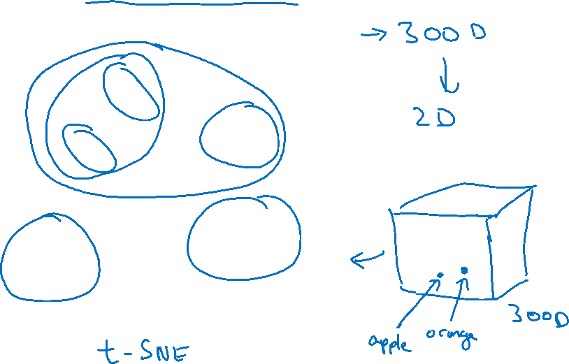
Visualizing word embeddings
man
woman
dog
king
cat
queen
fish
apple
grape
three
four
one
orange
two
[van der Maaten and Hinton., 2008. Visualizing data using t-SNE]

Slide 5
NLP and Word Embeddings
Using word embeddings
deeplearning.ai

Slide 6

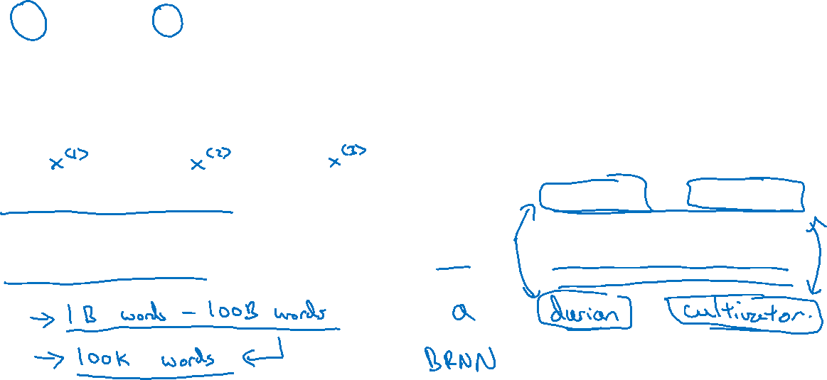

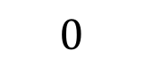
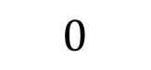
Named entity recognition example
$$1$$
$$1$$
$$0$$
$$0$$
$$0$$
$$0$$
Sally Johnson is an orange farmer
Robert Lin is an apple farmer

Slide 7
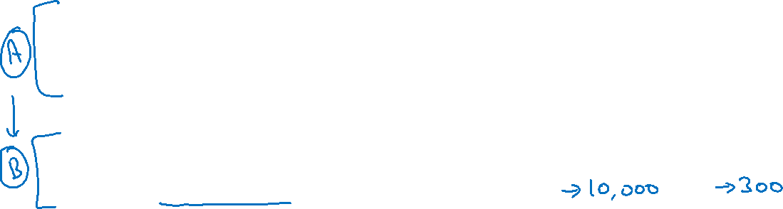
Transfer learning and word embeddings
Learn word embeddings from large text corpus. (1-100B words)
(Or download pre-trained embedding online.)
2. Transfer embedding to new task with smaller training set.
(say, 100k words)
3. Optional: Continue to finetune the word embeddings with new
data.

Slide 8
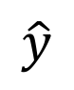
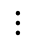
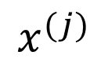
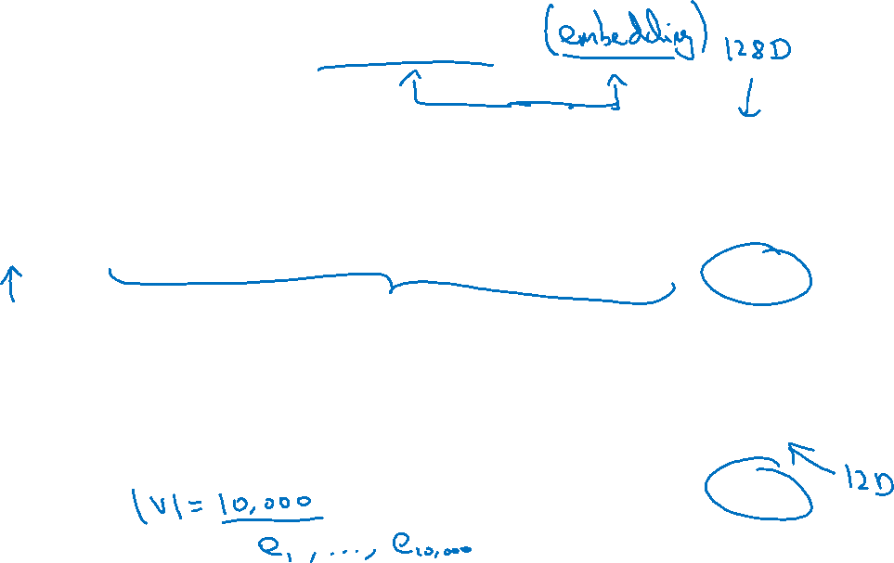
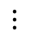
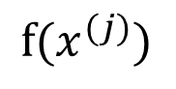
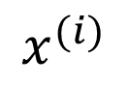
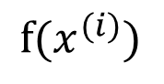
Relation to face encoding
$$⋮$$
$$x^{(i)}$$
$$f(x^{(i)})$$
$$\hat{y}$$
$$⋮$$
$$⋮$$
$$x^{(j)}$$
$$f(x^{(j)})$$
[Taigman et. al., 2014. DeepFace: Closing the gap to human level performance]

Slide 9
NLP and Word Embeddings
Properties of word embeddings
deeplearning.ai

Slide 10
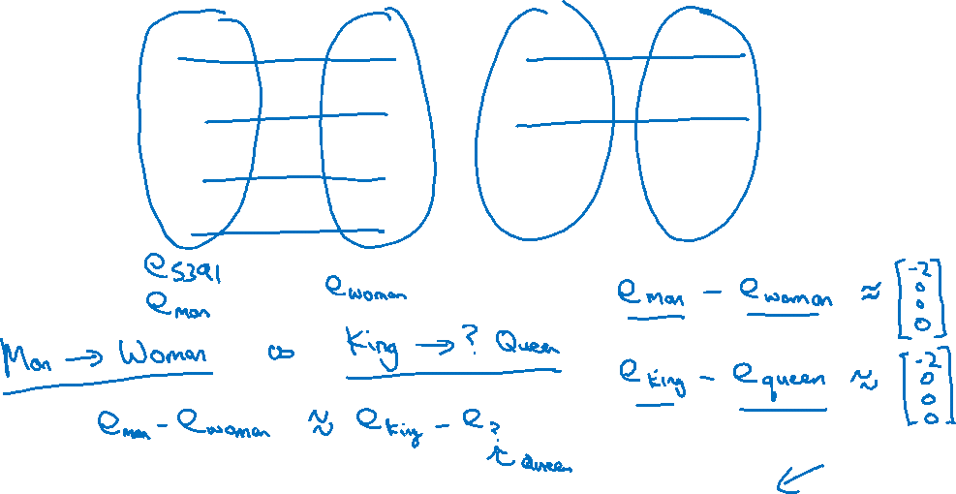
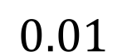
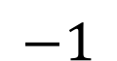
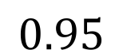
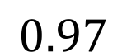
Analogies
Man
(5391)
Woman
(9853)
King
(4914)
Queen
(7157)
Apple
(456)
Orange
(6257)
Gender
$$−1$$
1
-0.95
$$0.97$$
0.00
0.01
Royal
$$0.01$$
0.02
0.93
$$0.95$$
-0.01
0.00
Age
0.03
0.02
0.70
0.69
0.03
-0.02
Food
0.09
0.01
0.02
0.01
0.95
0.97
[Mikolov et. al., 2013, Linguistic regularities in continuous space word representations]

Slide 11
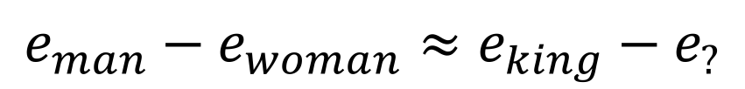
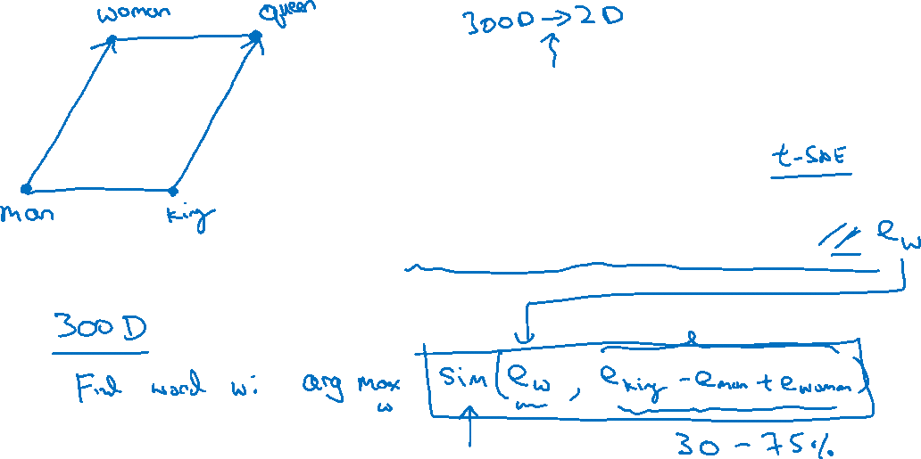
Analogies using word vectors
man
woman
dog
king
cat
queen
fish
three
four
apple
grape
one
two
orange
$$e_{man}−e_{woman}≈e_{king}−e_{?}$$

Slide 12
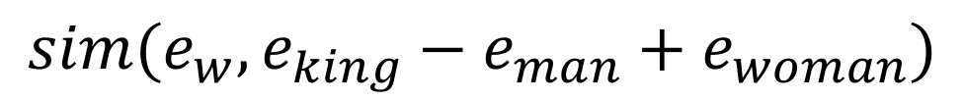
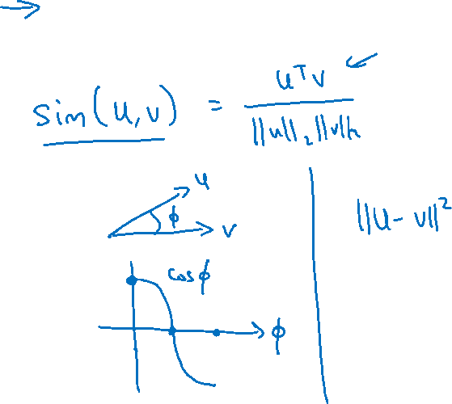
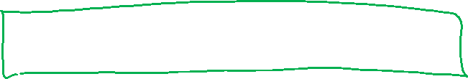
Cosine similarity
$$sim(e_{w}, e_{king}−e_{man}+e_{woman})$$
Man:Woman as Boy:Girl
Ottawa:Canada as Nairobi:Kenya
Big:Bigger as Tall:Taller
Yen:Japan as Ruble:Russia

Slide 13
NLP and Word Embeddings
Embedding matrix
deeplearning.ai

Slide 14
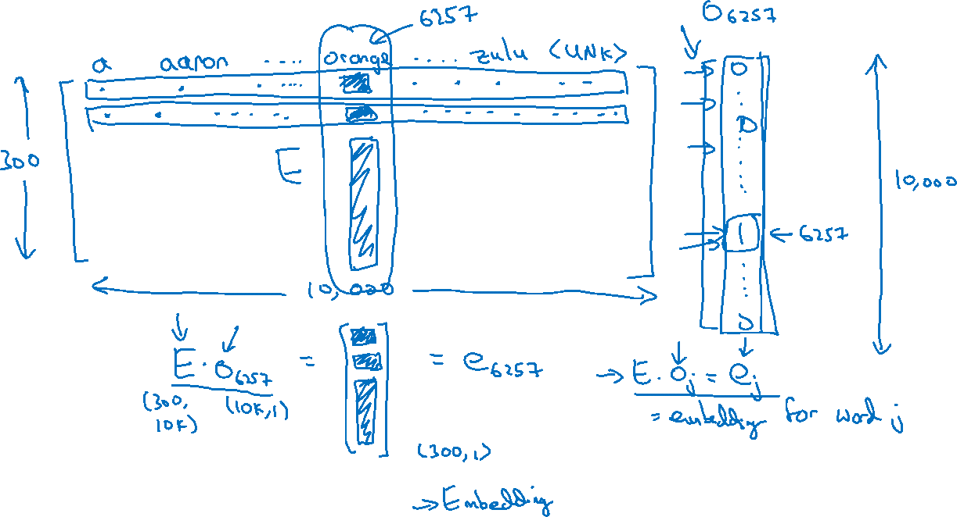
Embedding matrix
In practice, use specialized function to look up an embedding.

Slide 15
NLP and Word Embeddings
Learning word embeddings
deeplearning.ai

Slide 16
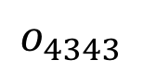
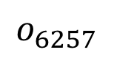
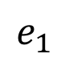
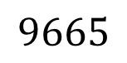
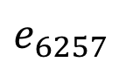
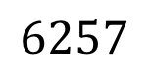
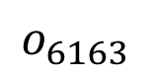
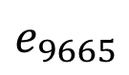
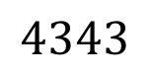
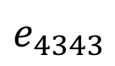
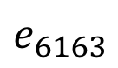
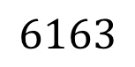
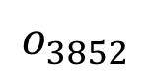
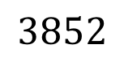
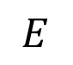
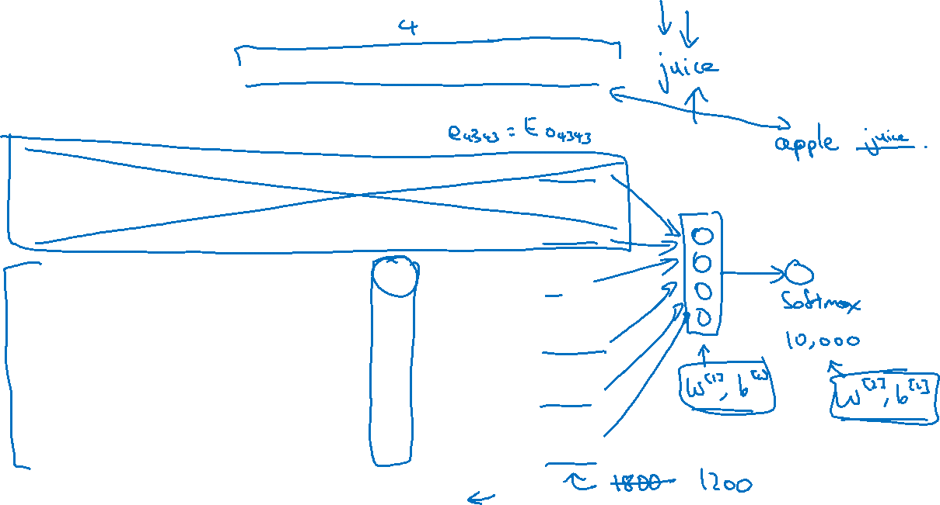





Neural language model
I want a glass of orange ______.
$$4343$$
$$9665$$
$$1$$
$$3852$$
$$6163$$
$$6257$$
I
$$o_{4343}$$
$$E$$
$$e_{4343}$$
want
$$o_{9665}$$
$$E$$
$$e_{9665}$$
a
$$o_{1}$$
$$E$$
$$e_{1}$$
glass
$$o_{3852}$$
$$E$$
$$e_{3852}$$
of
$$o_{6163}$$
$$E$$
$$e_{6163}$$
orange
$$o_{6257}$$
$$E$$
$$e_{6257}$$
[Bengio et. al., 2003, A neural probabilistic language model]

Slide 17

Other context/target pairs
I want a glass of orange juice to go along with my cereal.
Context: Last 4 words.
4 words on left & right
Last 1 word
Nearby 1 word

Slide 18
NLP and Word Embeddings
Word2Vec
deeplearning.ai

Slide 19

Skip-grams
I want a glass of orange juice to go along with my cereal.
[Mikolov et. al., 2013. Efficient estimation of word representations in vector space.]

Slide 20

Model
Vocab size = 10,000k

Slide 21




Problems with softmax classification
$$p\left(t | c\right)=\frac{e^{θ_{t}^{T}e_{c}}}{\sum_{j=1}^{10,000}{e^{θ_{j}^{T}e_{c}}}}$$
How to sample the context $c$?

Slide 22
NLP and Word Embeddings
Negative sampling
deeplearning.ai

Slide 23

Defining a new learning problem
I want a glass of orange juice to go along with my cereal.
[Mikolov et. al., 2013. Distributed representation of words and phrases and their compositionality]

Slide 24





Model
$$p\left(t | c\right)=\frac{e^{θ_{t}^{T}e_{c}}}{\sum_{j=1}^{10,000}{e^{θ_{j}^{T}e_{c}}}}$$
Softmax:
context
word
target?
orange
juice
$$1$$
orange
king
$$0$$
orange
book
$$0$$
orange
the
$$0$$
orange
of
$$0$$

Slide 25

Selecting negative examples
context
word
target?
orange
juice
$$1$$
orange
king
$$0$$
orange
book
$$0$$
orange
the
$$0$$
orange
of
$$0$$

